Slide 1
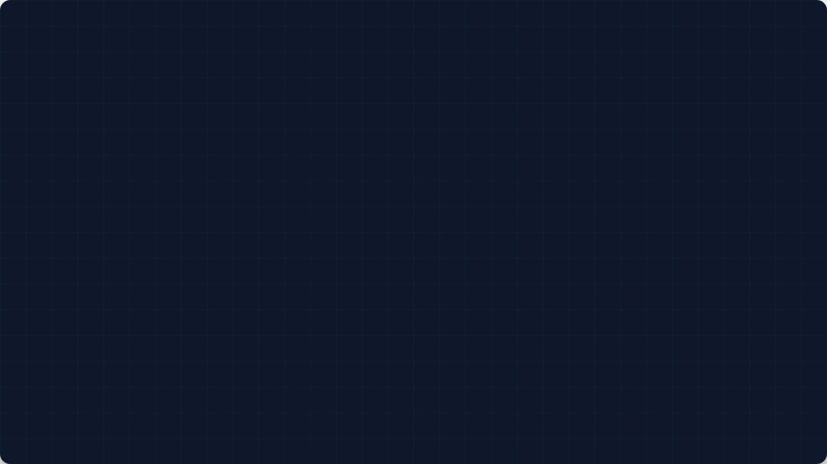
CCA GAME DEVELOPMENT · SESSION 4
Modern Art Generator
Let's turn Python code into a living, colorful digital canvas!
Teacher: Annisa Fairuz | Global Prestasi School

Slide 2












What are we building today? 🎯
1. Memory Refresh
2. Randomness
3. For Loops
4. Final Project
Learn how to bring "surprise" into our code using the random tool.
Learn how to tell the computer to repeat actions instantly.
Build your own automated Modern Art Generator in VS Code!
Quick check on PyGame Window coordinates (0,0) and RGB color mixing.

Slide 3





The Rules of Our Digital Canvas 🗺️
Screen Coordinates
RGB Colors
In PyGame, the math is slightly different from school!
We paint shapes by mixing light values.
•
The Origin : Always lives at the Top-Left corner.
•
Format:
•
Values range from 0 (Dark) to 255 (Bright).
•
X-Axis: Moves RIGHT as the number gets bigger.
•
Example: makes pure green!
•
Y-Axis: Moves DOWN as the number gets bigger.

Slide 4
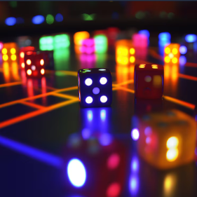
Randomness
Concept 1: Why Do We Need Randomness? 🎲
The Problem: If games always look the same, players get bored! We need unpredictability.
The Solution: We build a "dice roll" into our code.
The Tool: Type import random at the top of your file.
The Command: random.radint(min,max)
import random
#"Hey computer, pick a random number between 0 and 800!"
random_x = random.randint(0, 800)
random_y = random.randint(0, 500)
color = ( random.randint(0, 255), random.randint(0, 255), random.randint(0, 255))

Slide 5


Mini Practice 1: The Safe Border
The Scenario:
Your game window is 800 X 600 pixels. You want to spawn a box of size 50x50 randomly.
Rule: The box MUST NOT go off-screen!
The Question:
If the box is 50px wide, what is the maximum safe limit for the X coordinate so it doesn't get cut off on the right side?
Starter Code:
Fix the question marks in your editor!
import random
# TODO: Fix the max range so the 50px box stays inside the 800px window!
box_x = random.randint(0, ???)
print(“Safe Box X:", box_x)

Slide 6

For Loops
Concept 2: The Power of For Loops 🔄
The Problem: Typing pygame.draw.rect() 100 times manually is exhausting.
The Solution: Hire a digital robot to repeat the command instantly!
The Command: for i in range (N) tells Python how many times to repeat.
import random
#“Robot, repeat this drawing action 50 times in a split second!”
for i in range(50):
#drawing code goes here …
print(“Drawing shape number:", i)

Slide 7
Mini Practice 2: The Step Counter
The Scenario:
You want a loop to run 10 times. But instead of printing standard numbers (0 to 9), you want to print scaled steps: 0, 10, 20, 30...
Rule: The box MUST NOT go off-screen!
The Question:
How do you use the loop variable i to scale the output without changing range(10) ?
Starter Code:
Use math to fix the print statement!
for i in range (10)
# TODO: Multiply 'i' by a number to scale the step!
print(“Coordinate step:", ???)

Slide 8









Mini Practice 3: The Fusion
Write a script using a for loop to draw 50 squares on your PyGame window. Every square must have a random position and random color.
The Rule:
Every square must have a completely random position (x,y) and a random RGB color.
The Mission:
Write a script using a for loop to draw 50 squares on your Pygame window.
1. Setup the Loop
2. Randomize
3. Draw!
Start with for i in range(50) to tell your computer to draw 50 items.
Inside the loop, generate random X, Y positions and random R, G, B colors.
Use pygame.draw.rect() using the random variables you just created.

Slide 9

Mini Project 1:
Modern Art Canvas 🖼️
The Requirements:
1. Keep your Pygame window open using the standard game loop (running = True).
2. Use a loop to generate at least 150+ random geometric shapes (mix rects and circles!).
3. Creative Touch: Add a solid background color first before drawing your abstract art.
Run it in VS Code and watch your computer create unique art!

Slide 10
What Did We Master Today? 🎉
Coordinates System
Pygame uses (0,0) at the top-left corner. Y goes DOWN, X goes RIGHT.
Randomness
Using random.radint() brings surprise, variety, and unpredictability to our logic.
For Loops
for i in range()automates repetitive tasks instantly, saving us from writing hundreds of lines of code.
Next Session Preview...
Next week, we are going to learn how to make our shapes move across the screen!

